Slide 1
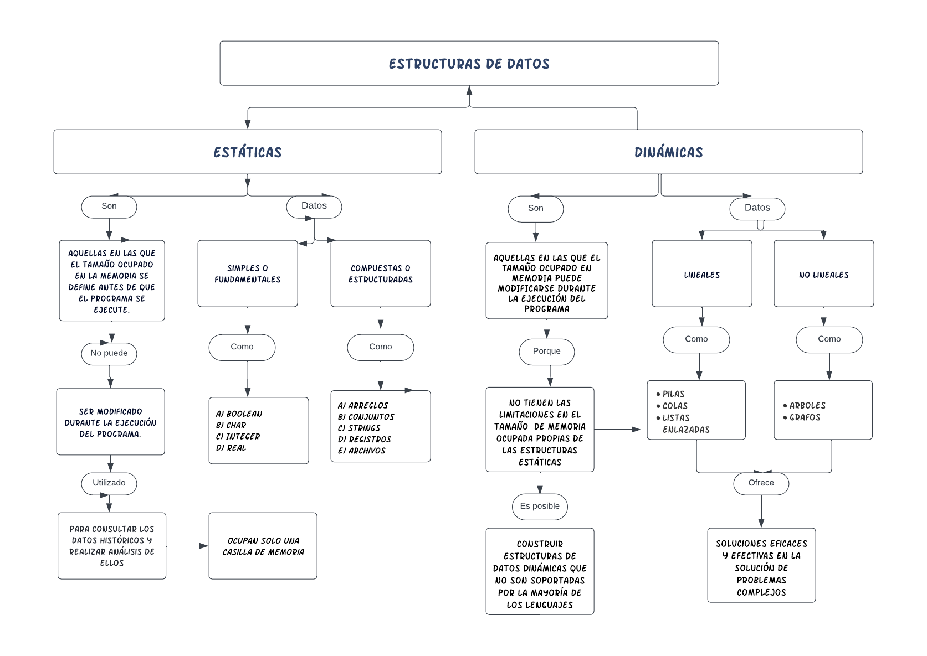

Slide 2
Andres Aley Quiroga Cortes. CC 1036599050
Elaborado en Blank diagram
https://lucid.app/lucidchart/ffef3f74-ae4d-4494-9943-91a86dcd5e35/edit?invitationId=inv_05cc1a37-9fa0-4a15-ba91-bbff8c1100e5

